Slide 1
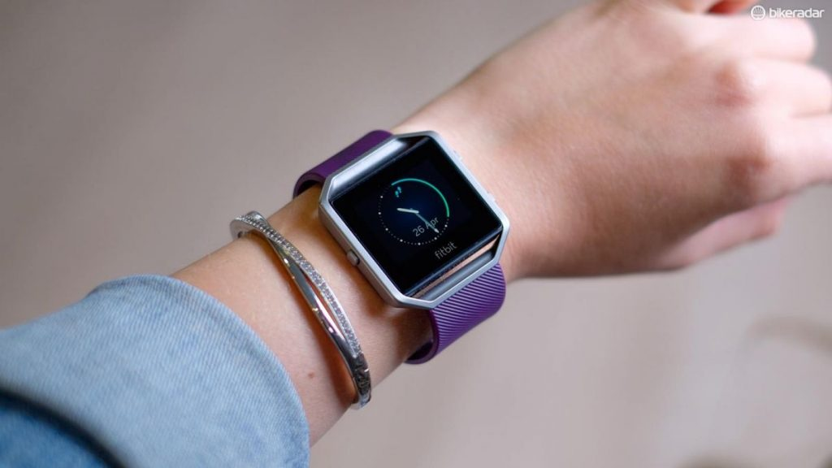
Bellabeat Case Study with R .
DATA ANLYTICS PROJECT
Done by : Nikhil Reddy Malle
Bharath University,Chennai.
Fitbit trackers

Slide 2
About a company
Bellabeat, a high-tech manufacturer of health-focused products for women. Bellabeat is a successful small company, but they have the potential to become a larger player in the global smart device market. Urška Sršen, cofounder and Chief Creative Officer of Bellabeat, believes that analyzing smart device fitness data could help unlock new growth opportunities for the company.
Table of Contents
Business task
Used Datasets
Installing and loading packages and libraries
Importing datasets
Fixing formatting
Exploring and summarizing data
Merging these two datasets together
Plotting
Summarizing recommendations for the business

Slide 3
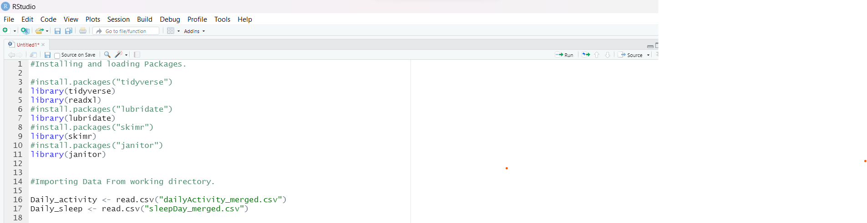
Business task
Identify potential opportunities for growth and recommendations for the Bellabeat marketing strategy improvement based on trends in smart device usage.
Used Datasets
Downloaded dataset to desktop from Kaggle public dataset of fitbit. Dataset is on open source and, reliable I am using only 2 datasets “dailyActivity_mearged” and "sleepDAy_merged".
Installing and loading Packages using R Programming.

Slide 4

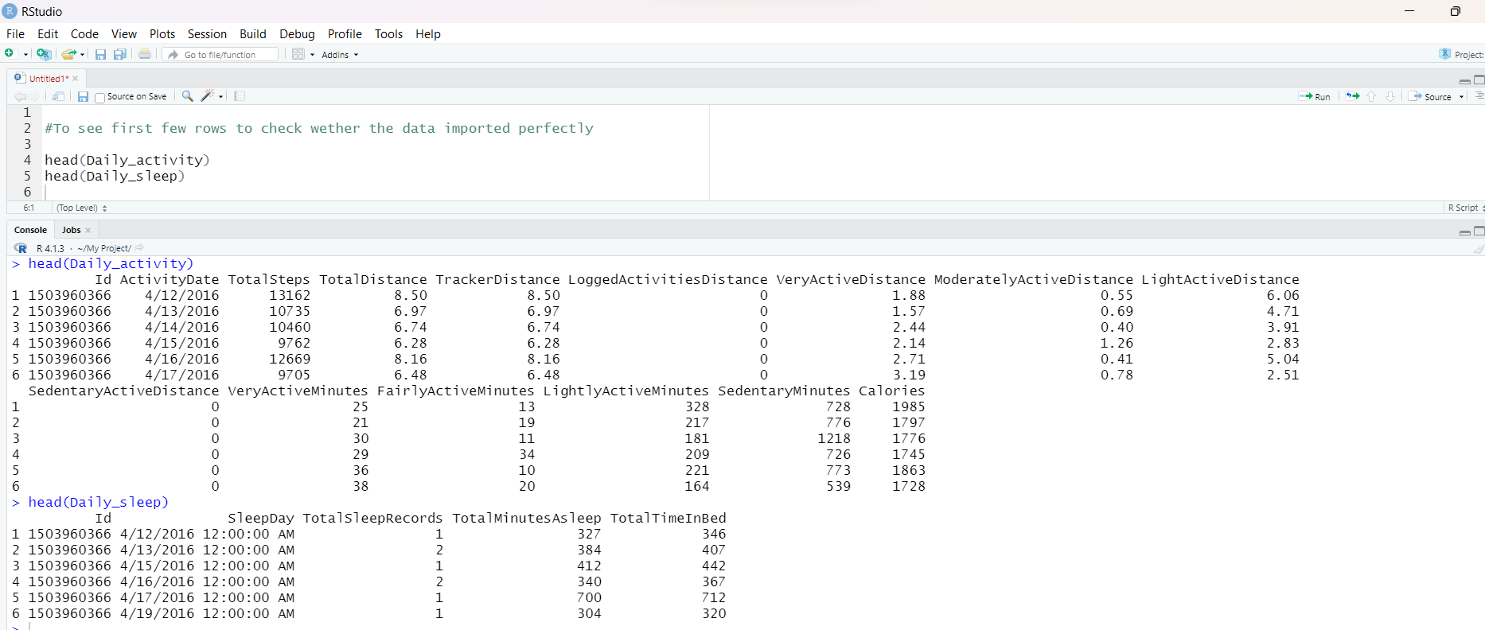
To check the first few records whether the data imported perfectly or not.

Slide 5
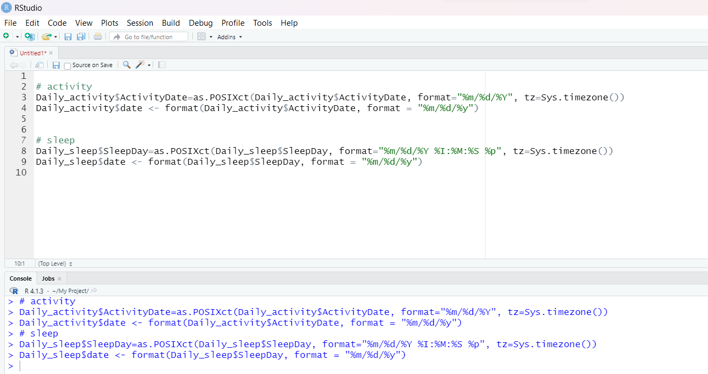
I spotted some problems with the timestamp data. So before analysis, I need to convert it to date time format and split to date and time.
Formatting Data

Slide 6
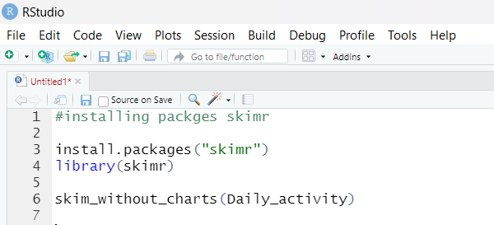
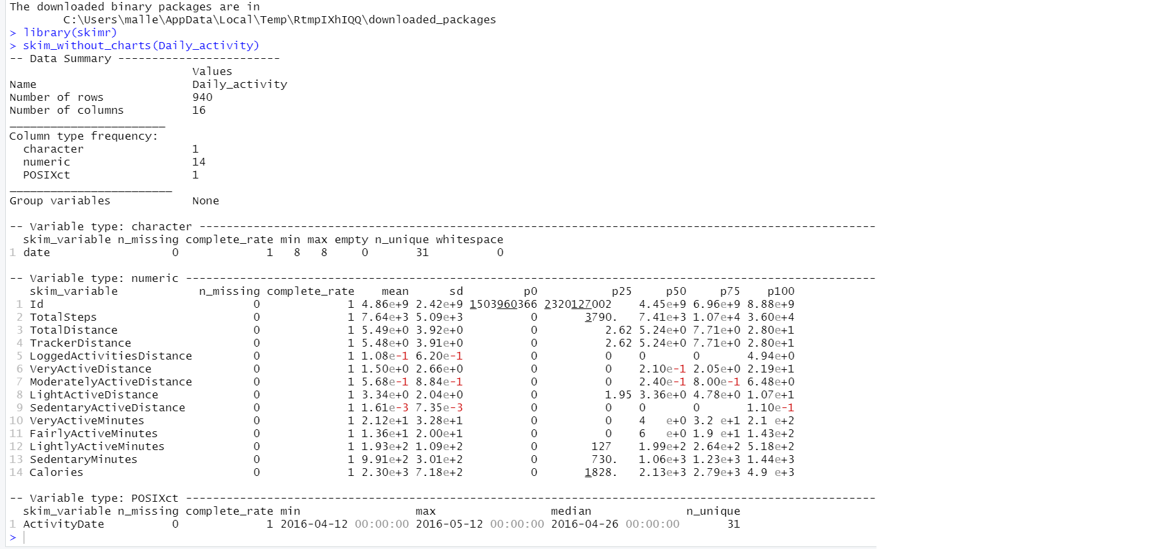
Now that everything is ready, so that, I can start exploring data sets.

Slide 7

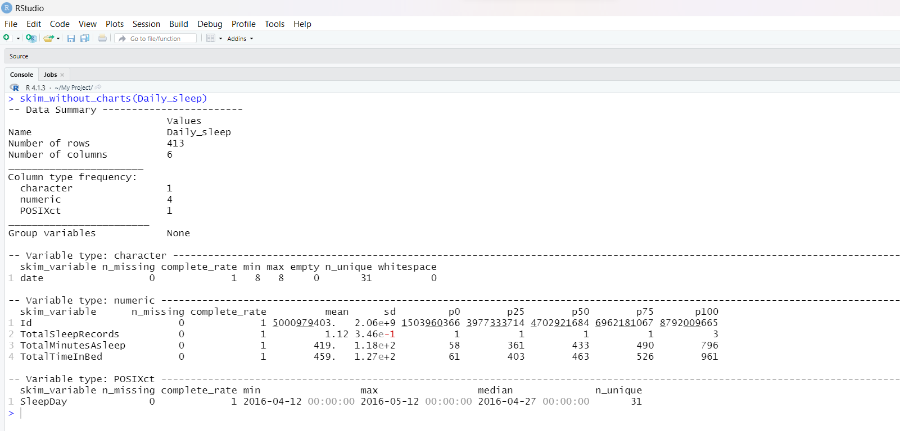

Slide 8

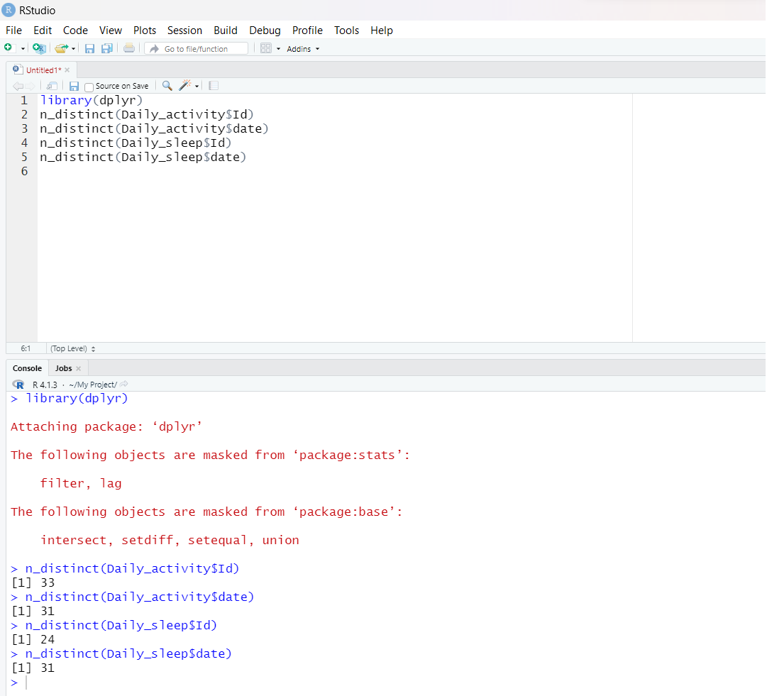
Some missing rows noticed in both tables.
Data with 33 customers with 31 Days results in 1023 rows, but there is 940 rows in Daily_activity and 413 rows in Daily_sleep. Number of missing rows in Daily_activity is 83 and in Daily_sleep is 610.

Slide 9
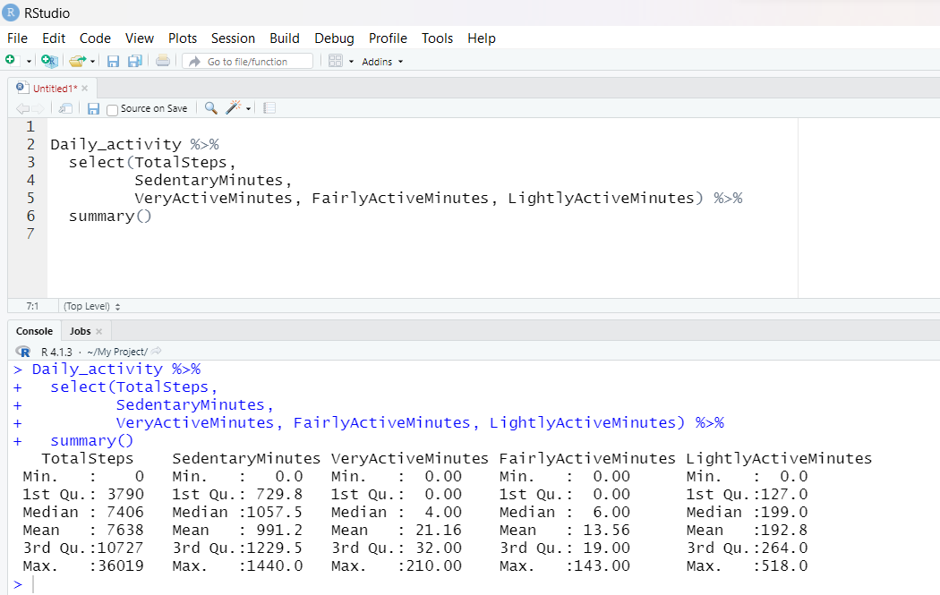
This information tells us about number participants in each data sets.
There is 33 participants in the activity, and 24 in the sleep. There is 31 days observation in the activity, and 31 in the sleep.
Quick look at summary of different variables.
For the daily activity data frame:

Slide 10
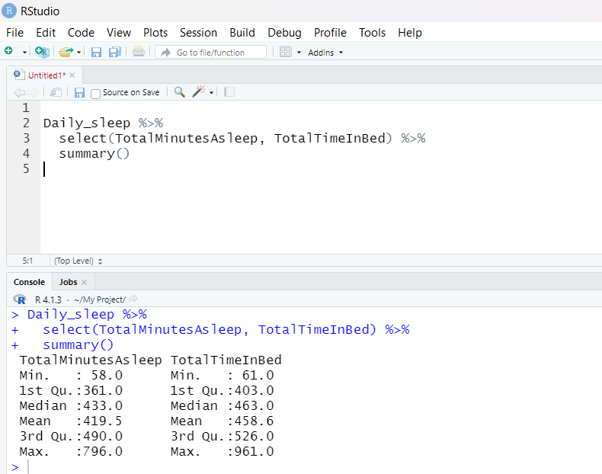
For the daily sleep data frame:
Some interesting discoveries from this summary:
Average sedentary time is 991 minutes or 16 hours. Definetly needs to be reduced! Sedentary means the time user does any activity involving a very low energy expenditure.
The majority of the participants are lightly active.
Assuming when "Total time in bed" > "Total minutes asleep" participants are unable to sleep for some time after going to bed. On the average, participants sleep 1 time for 7 hours

Slide 11
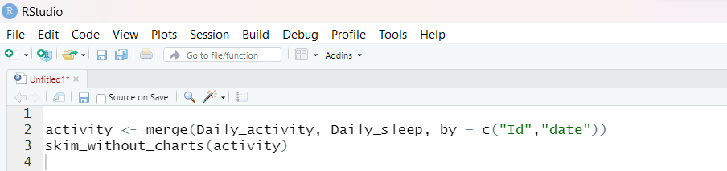
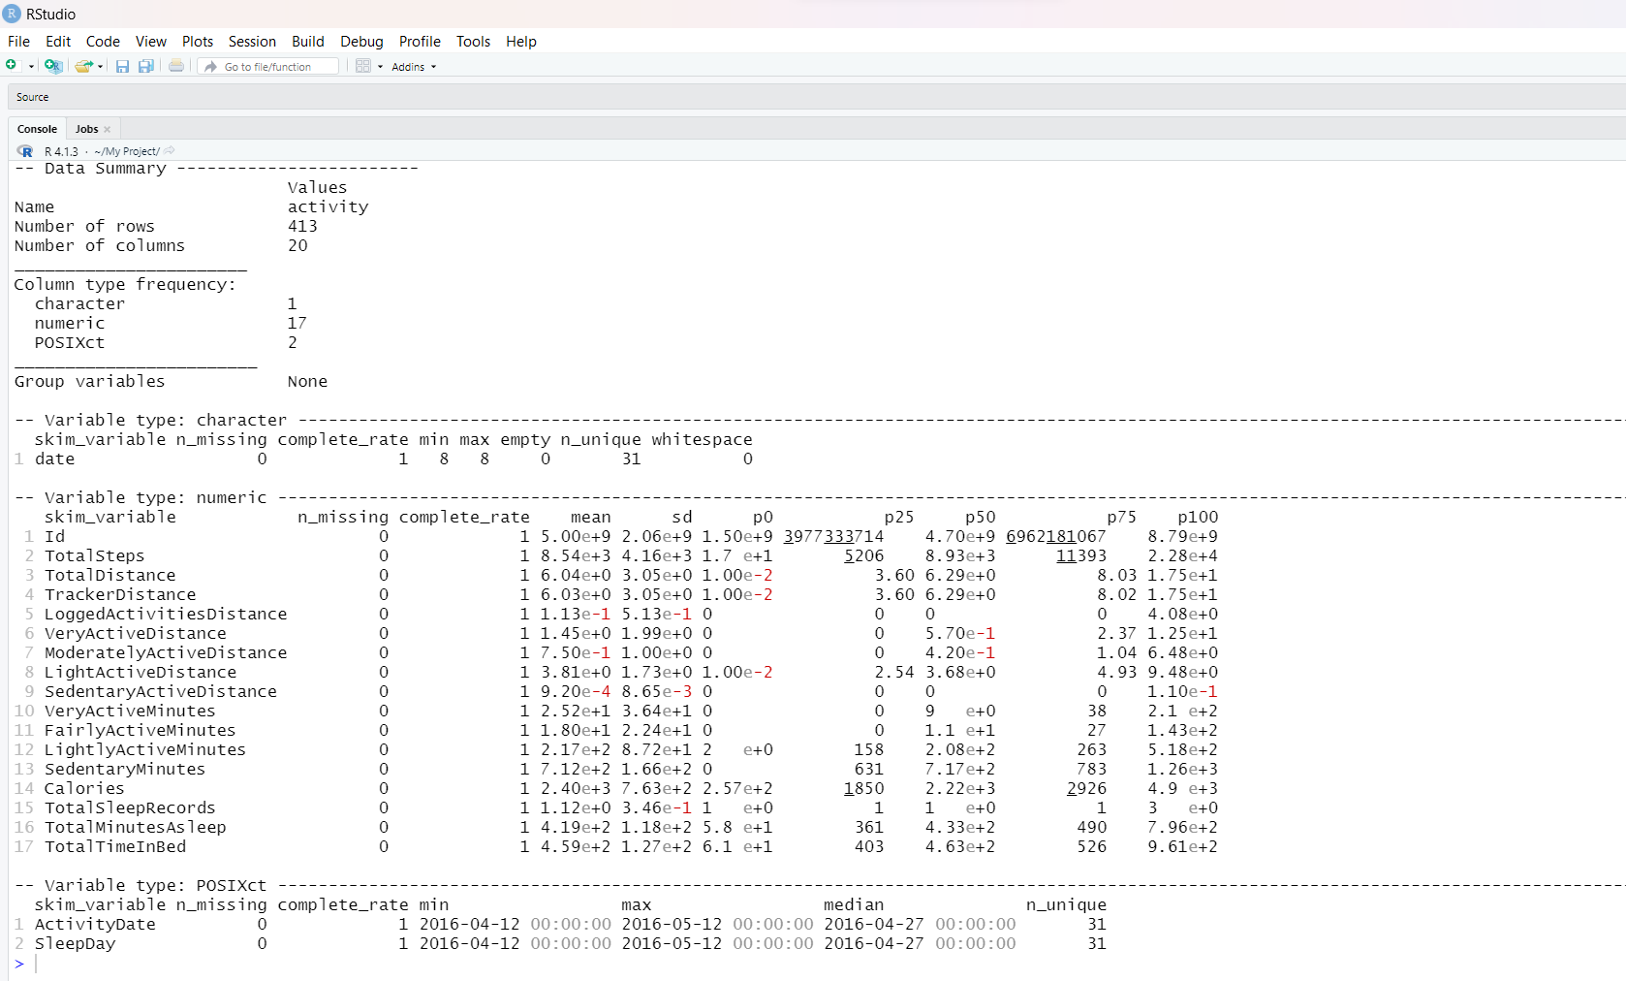
Merging these two datasets together
Before beginning to visualize the data, I need to merge two data sets. I’m going to merge (inner join) Daily_activity and Daily_sleep on columns Id.

Slide 12
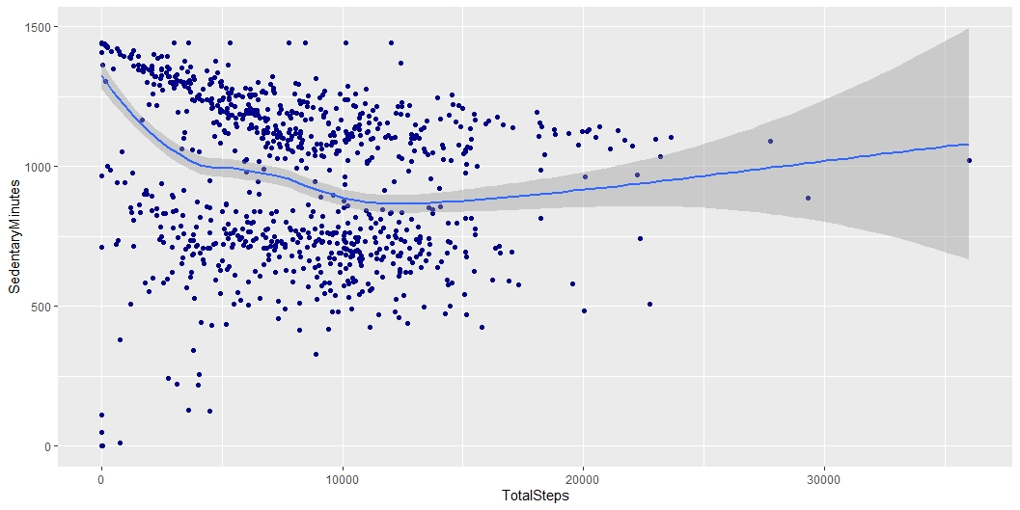
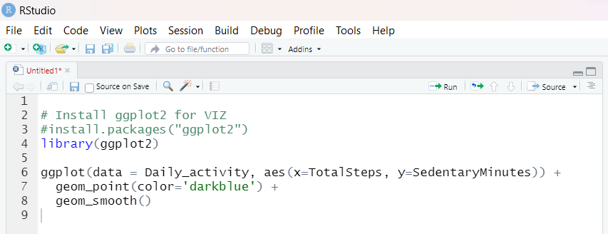
Plotting
Sedentary means the time user does any activity involving a very low energy expenditure. I see negative correlation here between Total Steps and sedentary minutes. which is obvious - more we walk more active we are. So if the Bellabeat user get some medal and badge by completing daily steps, that keeps them motivate.

Slide 13
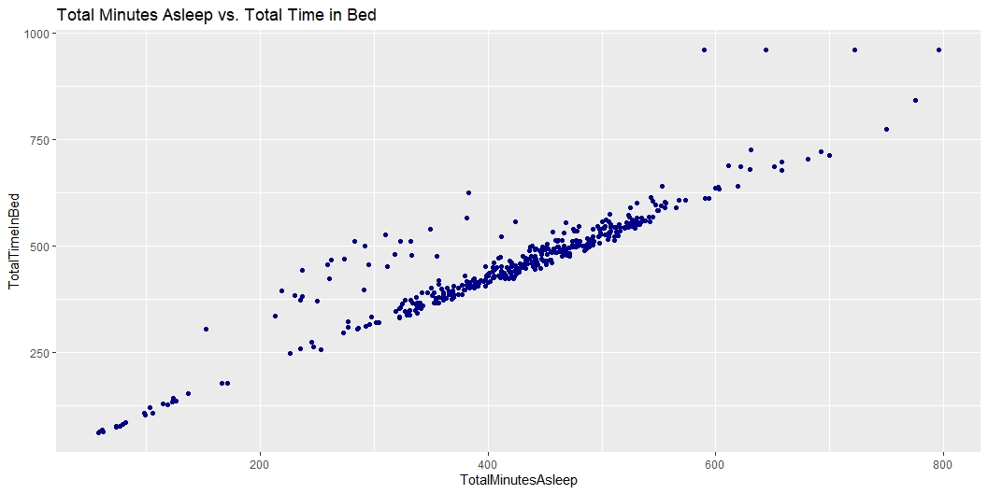
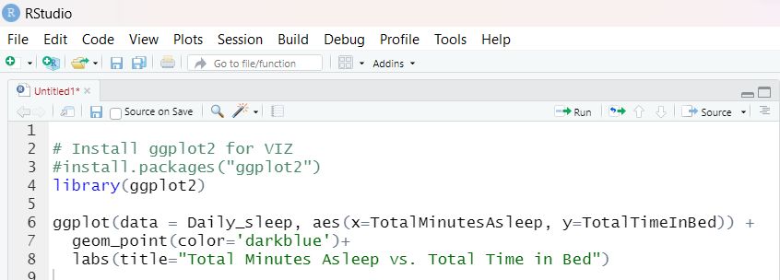
Relationship between Total minutes asleep and Total time in bed :-
The relationship between Total Minutes Asleep and Total Time in Bed looks linear. So if the Bellabeat users want to improve their sleep, we should consider using notification to go to sleep.

Slide 14
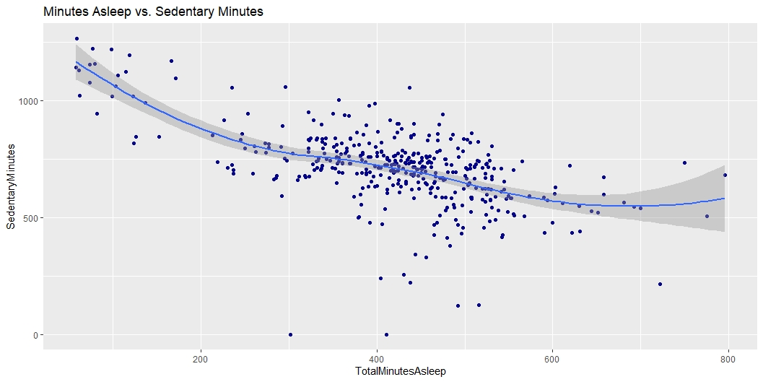
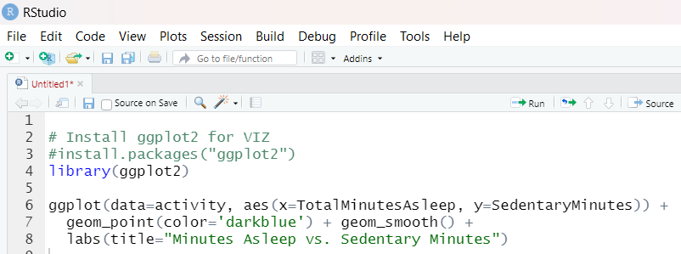
Relationship between Total Minutes Asleep and Sedentary Minutes:-
Here we can clearly see the negative relationship between Sedentary Minutes and Sleep time.
As an idea: if Bellabeat users want to improve their sleep, Bellabeat app can recommend reducing sedentary time.
Keep in mind that we need to support this insights with more data, because correlation between some data doesn’t mean causation.

Slide 15
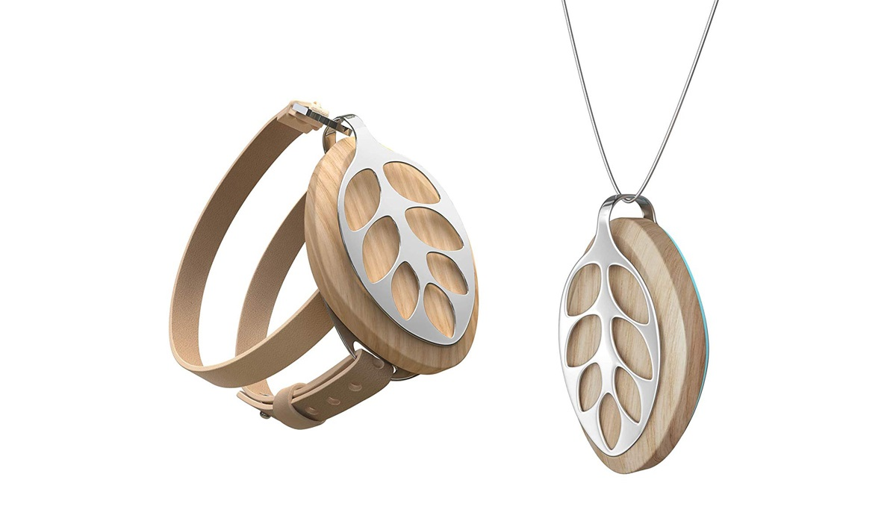
Summarizing recommendations for the business
As we already know, collecting data on activity, sleep, stress, and reproductive health has allowed Bellabeat to empower women with knowledge about their own health and habits. Since it was founded in 2013, Bellabeat has grown rapidly and quickly positioned itself as a tech-driven wellness company for women.
This Photo by Unknown Author is licensed under CC BY-NC-ND

Slide 16
After analyzing FitBit Fitness Tracker Data, I found some insights that would help influence Bellabeat marketing strategy.
Target audience:
Women who work full-time jobs and spend a lot of time at the computer/in a meeting/ focused on work they are doing (according to the sedentary time data).
The key message for the Bellabeat online campaign.
The Bellabeat app is not just another fitness activity . It’s a guide (a friend) who empowers women to balance full personal and professional life and healthy habits and routines by educating and motivating them through daily app recommendations.
Ideas for the Bellabeat app
Average total steps per day are 7638 which a little bit less for having health benefits for according to the CDC research. They found that taking 8,000 steps per day was associated with a 51% lower risk for all-cause mortality (or death from all causes).
If users want to improve their sleep, Bellabeat should consider using app notifications to go to bed.
Most activity happens between 5 pm and 7 pm - I suppose, that people go to a gym or for a walk after finishing work. Bellabeat can use this time to remind and motivate users to go for a run or walk.
As an idea: if users want to improve their sleep, the Bellabeat app can recommend reducing sedentary time.

Slide 17
THANK YOU

